Slide 1





Nephron Midterm Presentation
Drug Pricing Analysis
neph·ron/ˈnefrän/ noun: The functional unit in the kidney which filters waste from what is essential for life
Nephron has emerged as an important voice on managed care and pharmaceutical supply chain policy and economics, helping manufacturers and supply chain participants navigate the increasingly complex Payor/PBM marketplace
Founded in 2017 by Eric Percher and Josh Raskin, Nephron Research has established itself as the market’s leading independent healthcare equity research provider, filtering market noise from the insights that are essential to the investment process

Slide 2

The Problem
How can Nephron provide their clients with actionable insights and predictions for investments?
For the Columbia Team, can we find patterns among various drug groups and build a predictive model to anticipate drug price changes?
2

Slide 3

Our Approach
1
Perform exploratory data analysis to understand how and when drug prices change
How often do drug prices change? Do they always increase and by how much?
What time of year do drug prices change?
What role does volume play in predicting drug prices?
What are the relationships between drug classes?
Use these findings to create a predictive model for drug prices
When will a drug price change?
To what degree will the drug price change?
Ultimately, how will these drug price changes impact the market?
2
3

Slide 4
Findings

Slide 5
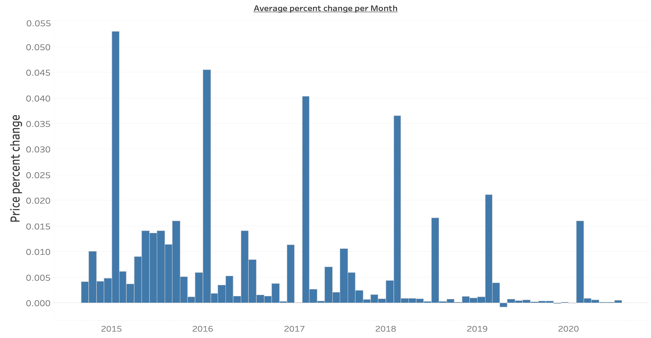
Price Changes Tend to Occur Annually at the Beginning of the Year
Average Price Percent Change of All the Drugs in the Market per Month
5

Slide 6
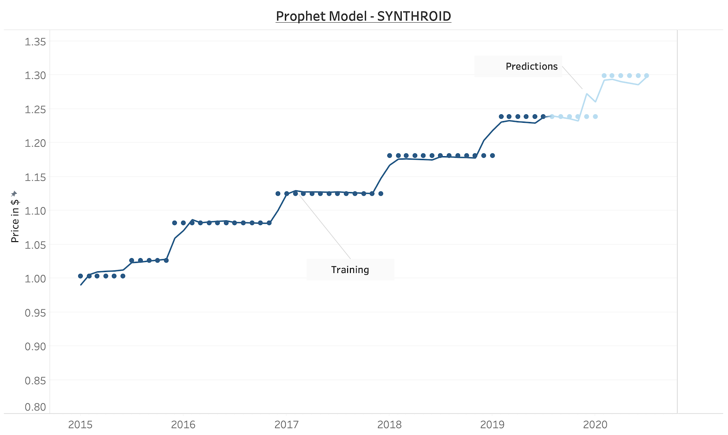
Predicting Individual Drug Price Changes Using Prophet
6

Slide 7
Our Prophet Model Results
Metric 1: Mean Average Error (MAE) between predicted month of price change and actual month of price change
Unit Months | Prophet Model 10/12 | Updated Model 10/25
Pain | 2.42 | 0.82
Oncologics | 2.73 | 0.77
Thyroid | 2.14 | 0.01
Metric 2: MAE between predicted price change rate and actual price
change rate
Unit % | Prophet Model 10/12 | Updated Model 10/25
Pain | 0.026 | 0.021
Oncologics | 0.022 | 0.014
Thyroid | 0.034 | 0.016
7

Slide 8
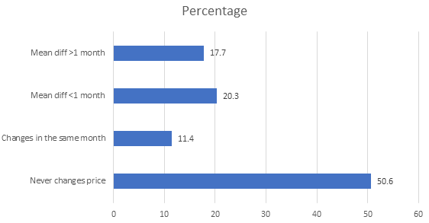
>80% of Drugs Either Never Change Price or on Average Change Price within the Same Month Each Year
8
Notes:
How good is our model? Most drugs never change price. We looked at all of the drugs in our dataset and made a striking discovery: over 80% of drugs either never change price year-over-year or on average change their price within the same month each year. By using the previous year’s change month as the prediction, we should have even better accuracy than the original Prophet model shared on Monday, 10/12. In fact, when we updated our model to use the previous year’s change month as a prediction for this year, instead of the Prophet model, our predictions were dramatically better (as seen in the table below). For the 17.7% of drugs that do not change on the same month each year, the original Prophet model is still likely to perform best, and we will look to tailor our model based on these historical trends for each drug.

Slide 9
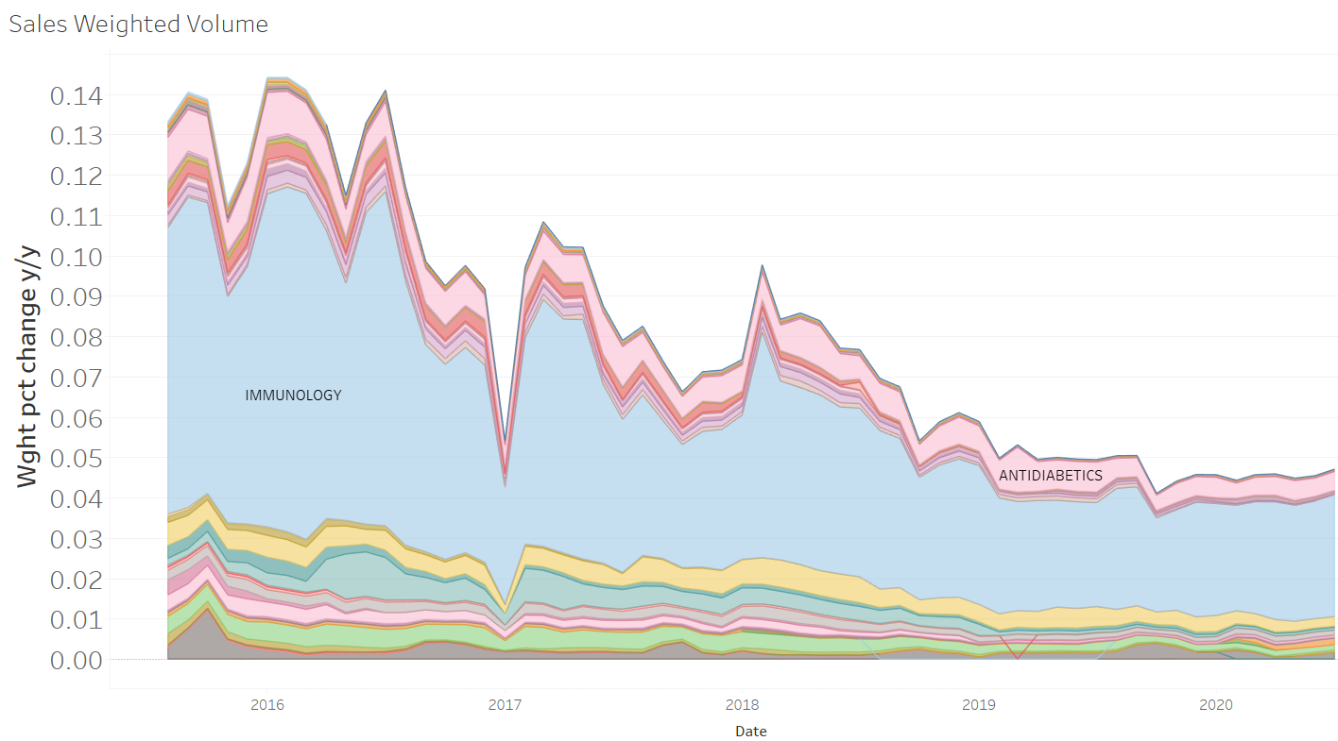
Sales Weighted, Year-Over-Year Drug Prices Have Increased at a Slower Rate over the Last 5 Years
9

Slide 10
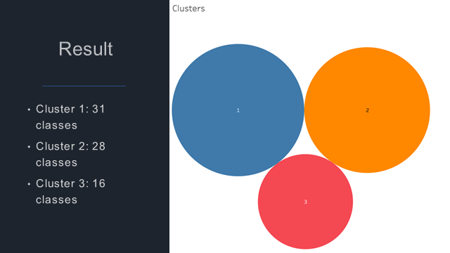
Cluster Analysis (Hierarchical Clustering) at the Drug Class Level Old-age/middle-old age/young-female
3 Clusters Identified at the Drug Class Level
10
Notes:
Here are some big picture labels
Cluster 1 (old-age onset)
Cluster 2 (middle-old age onset)
Cluster 3 (young/female skewed)
Cluster 1 (old, off-patent drugs, lots of generics; cheap)
Cluster 2 (newer, more expensive therapies)
Cluster 3 (other; not the bulk of drug revenue) – it’s a mix of brand and generic, but incentive towards brands is sig. lower than for cluster 2

Slide 11
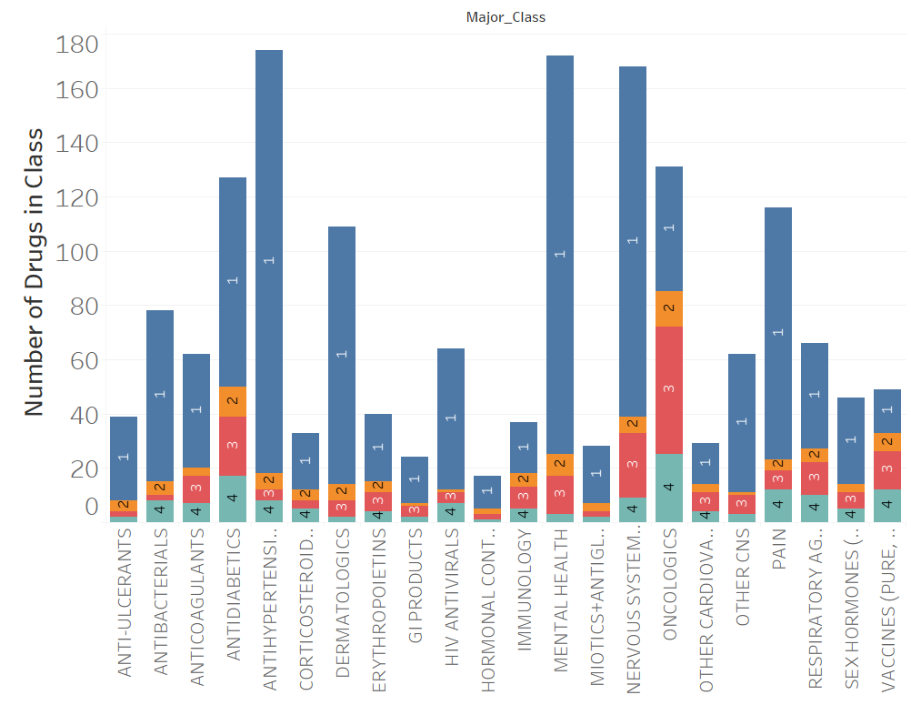
Clustering on the Individual Drug Level: Is Drug Class Useful?
11

Slide 12
Next Steps and Timeline
Finish predictive model for price - 11/2
Iterate on predictive model - Move from predicting price changes to volume and sales changes - Predicting Volume- 11/9 ; Predicting Revenue – 11/16
Incorporate Sentiment Analysis - 11/23
Incorporate Cluster Analysis. Evaluate if using Drug Class vs Cluster ID offers better results?
12

Slide 13
Questions?

Slide 14
Appendix

Slide 15
Definitions
TRx – This measure represents the counts of total (new plus refill) prescriptions (scripts) dispensed by pharmacists
WAC - Wholesale Acquisition Cost
The manufacturer’s reported list price for a prescription pharmaceutical for sale to wholesalers
Each manufacturer establishes its own WAC by using its own formula.
Like AWP, WAC is a suggested price that often does not represent what a wholesaler or end-provider actually pays for the pharmaceutical, because WAC does not include manufacturer incentives such as rebates, volume purchase agreements, and prompt-payment discounts.
However, unlike AWP, WAC is statutorily defined in the U.S. Code:
The term “wholesale acquisition cost” means, with respect to a pharmaceutical or biological, the manufacturer’s list price for the pharmaceutical or biological to wholesalers or direct purchasers in the United States, not including prompt pay or other discounts, rebates or reductions in price, for the most recent month for which the information is available, as reported in wholesale price guides or other publications of pharmaceutical or biological pricing data.
Pros: Nationally standardized price (codified in legislation), broadly accepted, brands frequently updated, tied to supplemental rebates (increases to WAC will result in increases in supplemental rebates)
Cons: Semi-transparent, no oversight, not reflective of actual prices for brand or generic (but closer than AWP for brand), not comprehensive, generics not frequently updated, NCPDP endorsed replacement benchmark
15

Slide 16
Weighting Formula
Sales Weighted, Year-Over-Year WAC Price Change Rate = ∑ [(Specific Drug Sales / All Drug Sales for a given month) * Year-Over-Year WAC Price Change for each drug)]
Sales Weighting calculated for the entire drug market and for each drug class
Year-Over-Year WAC price change was recommended by Nephron to remove seasonal effects
Sales = WAC Price * TRx Volume
16

Slide 17
Hierarchical Clustering
Methodology:
Compute monthly sales= TRx* WAC for each class
Build the correlation matrix
We used a hierarchical clustering method to create different groups of drugs
The metric used for clustering was drugs or classes sales correlation as we needed to group drugs behaving similarly
First, we computed the euclidian distance between correlation using the PDIST function
Second, we use the Scipy hierarchical linkage function ( using a complete method) to create clusters based on the distance computed earlier
COVID-19 time period excluded
17

Slide 18
Methodology on Prophet model
Intro to prophet:
Prophet is a procedure for forecasting time series data based on an additive model where non-linear trends are fit with yearly, weekly, and daily seasonality. It works best with time series that have strong seasonal effects and several seasons of historical data.
Some parameters:
Daily and weekly seasonalities are not useful. We turn on yearly seasonality only.
Take changepoint_prior_scale to equal 0.05 to avoid overfitting
Data: 4k drugs
Train set: 2014.8-2019.7
Test set: 2019.8-2020.7
Regressors:
WAC price
Logarithm of previous 6 months average TRx
18

Slide 19
Mitigates
Besides historical price and volume data (and other categorical information we have), there are many factors that affect drug pricing
This includes policy, insurance, and distribution
Even the best predictive model for drug prices will be sensitive to these factors, which might not be anticipated or captured through historical data (example, impact of COVID, or what happens after 2020 elections)
19

